Slide 1

Credit: Exploratory dAta analysis - Case Study
By:
Swati Balla - DDS2070314
Prakher Hajela - DDS2070187

Slide 2
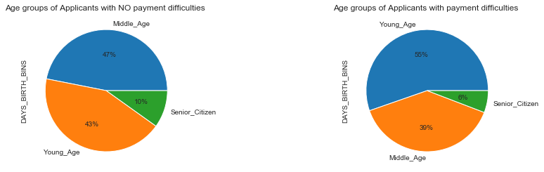

Univariate Analysis: DAYS_BIRTH w.r.t TARGET Variable.

Slide 3
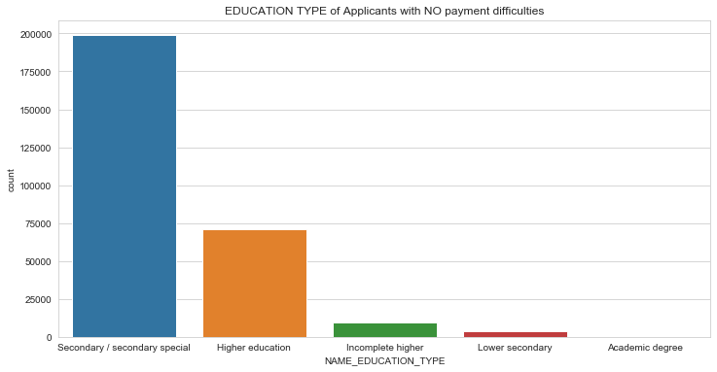
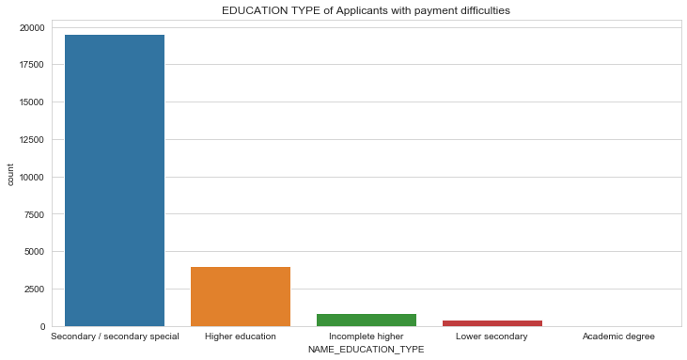
Univariate Analysis: NAME_EDUCATION_TYPE w.r.t TARGET Variable.

Slide 4
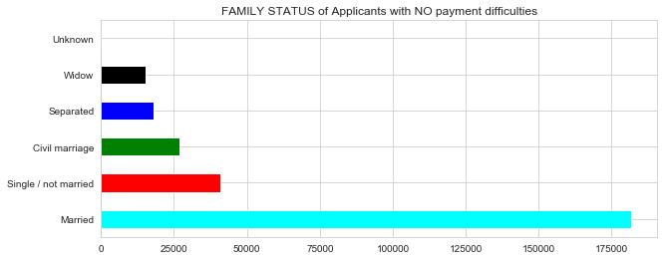
Univariate Analysis: NAME_FAMILY_STATUS w.r.t TARGET0 Variable.

Slide 5
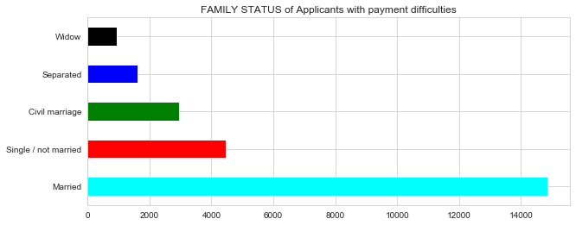
Univariate Analysis: NAME_FAMILY_STATUS w.r.t TARGET1 Variable.

Slide 6
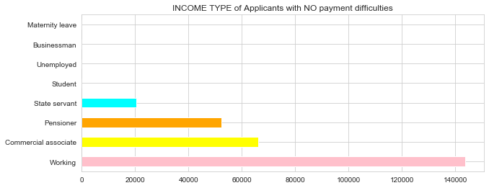
Univariate Analysis: NAME_INCOME_TYPE w.r.t TARGET0 Variable.

Slide 7
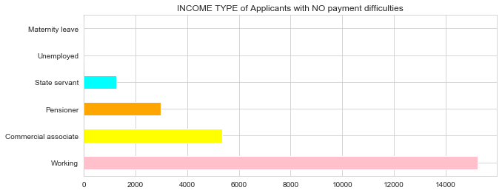
Univariate Analysis: NAME_INCOME_TYPE w.r.t TARGET1 Variable.

Slide 8
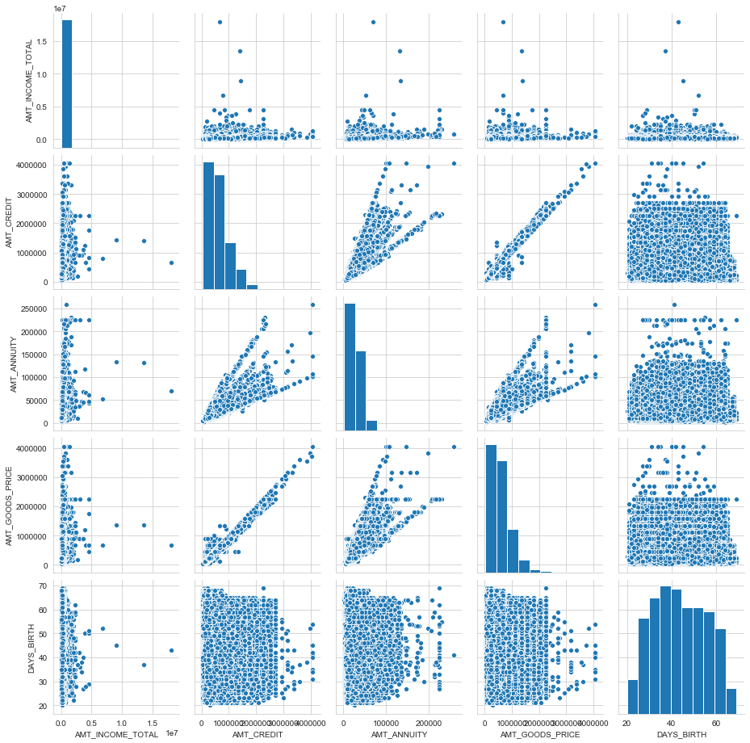
Bivariate Analysis: Pair Plots wrt to TARGET 0 Variable
AMT_INCOME_TOTAL
AMT_CREDIT
AMT_ANNUITY
AMT_GOODS_PRICE
DAYS_BIRTH

Slide 9
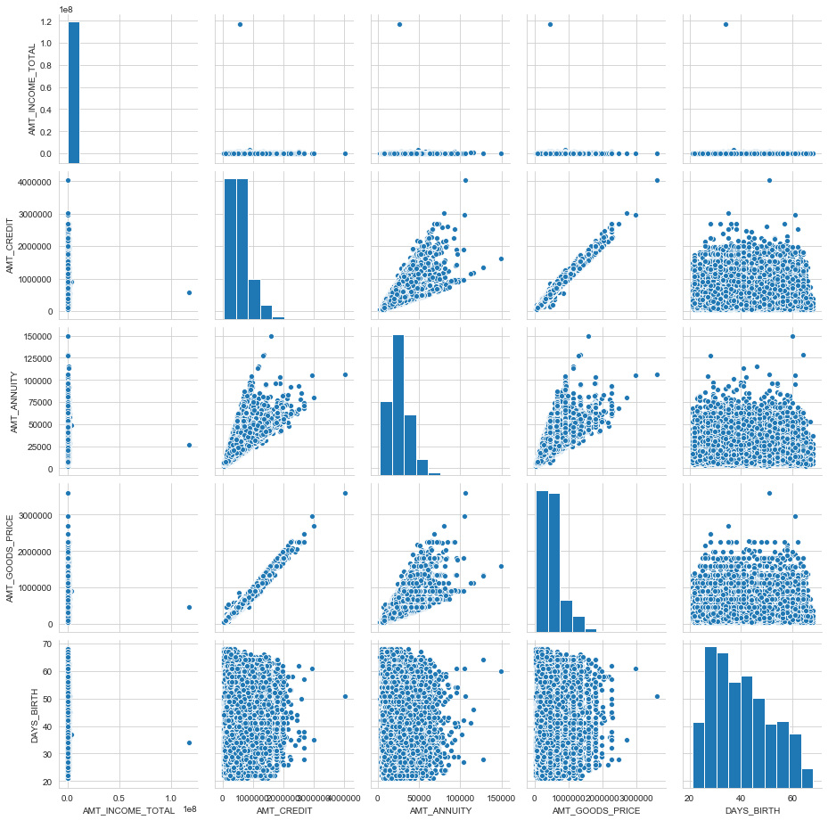
Bivariate Analysis: Pair Plots wrt to TARGET 1 Variable
AMT_INCOME_TOTAL
AMT_CREDIT
AMT_ANNUITY
AMT_GOODS_PRICE
DAYS_BIRTH

Slide 10
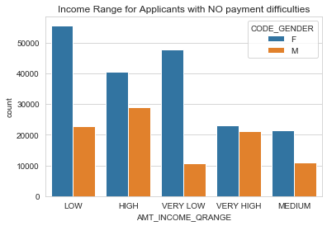
AMT_INCOME_QRANGE BY GENDER w.r.t TARGET Variable 0
In terms of counts LOW income range has the maximum aplications while Medium income group has the lowest applications.
Within Low, High and Very Low Income range it is evident that Female applicants are significantly more than male applicants.
For Very High Income range both Male and Female have a balanced ratio with Female applicants being slightly higher in count.

Slide 11
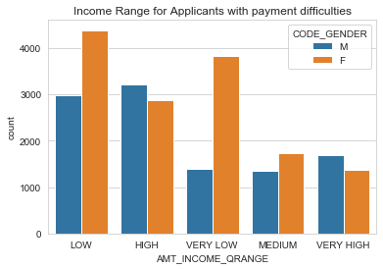
AMT_INCOME_QRANGE BY GENDER w.r.t TARGET Variable 1
In terms of counts LOW income range has the maximum applications while Very High income group has the lowest applications.
Within Low, Very Low Income range it is evident that Female applicants are significantly more than Male applicants.
For Very High Income range both Male and Female have a balanced ratio with Male applicants being slightly higher in count.

Slide 12
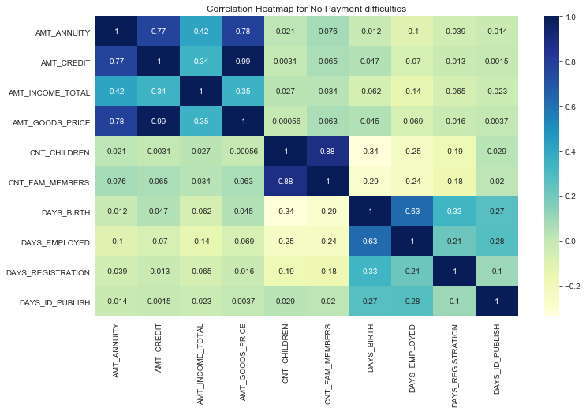
Correlation Heat Map for Target Variable 0

Slide 13
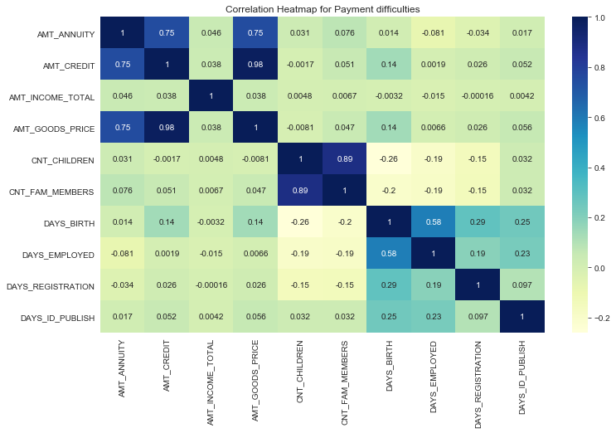
Correlation Heat Map for Target Variable 1

Slide 14
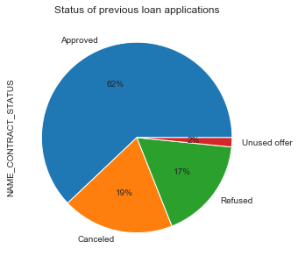

Univariate Analysis based on the NAME_CONTRACT_STATUS data column

Slide 15
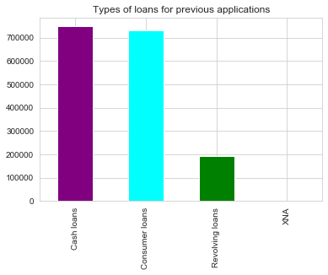
Univariate Analysis based on the NAME_CONTRACT_TYPE data column

Slide 16
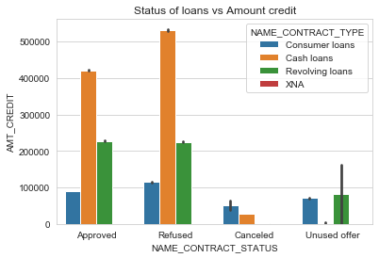
Bivariate Analysis between NAME_CONTRACT_STATUS and AMT_CREDIT data columns

Slide 17
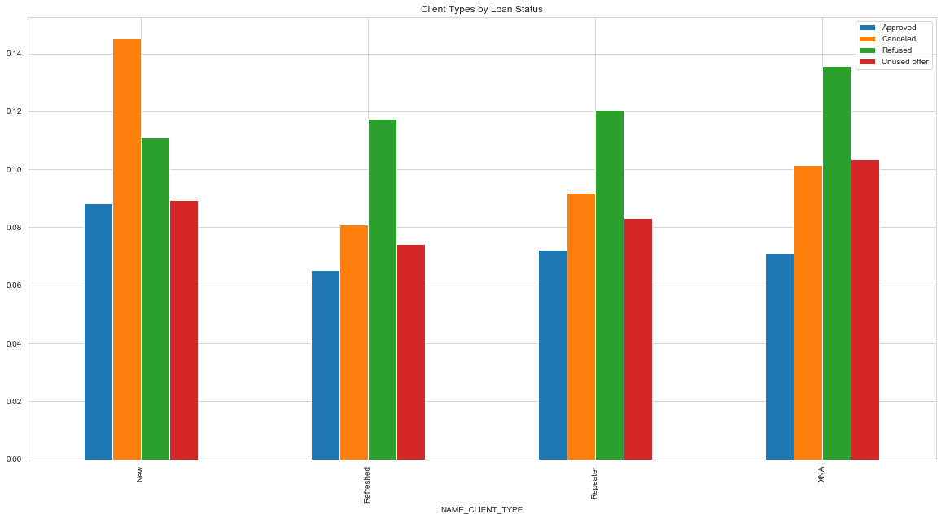

Pivot Table Analysis for NAME_CLIENT_TYPE by Loan Application Status

Slide 18
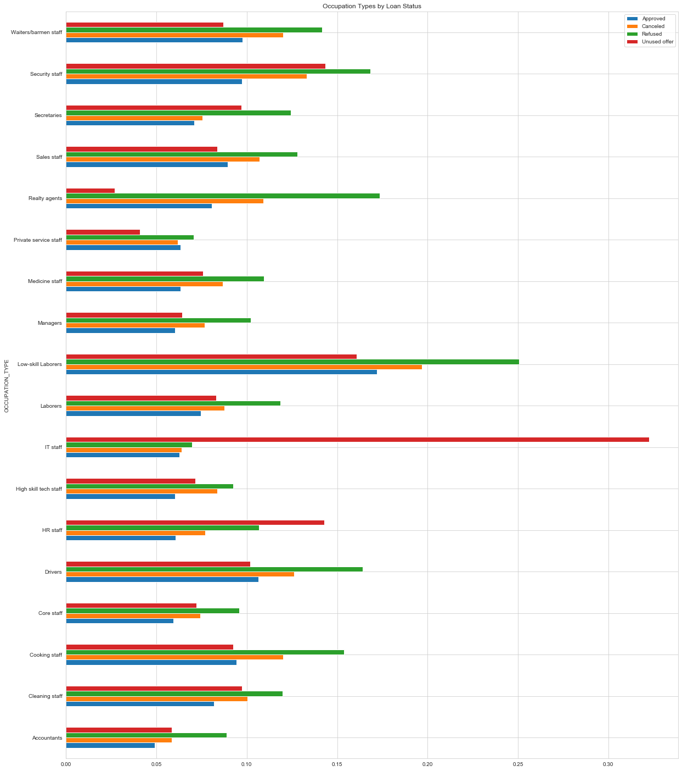
Pivot Table Analysis for OCCUPATION_TYPE by Loan Application Status

Slide 19
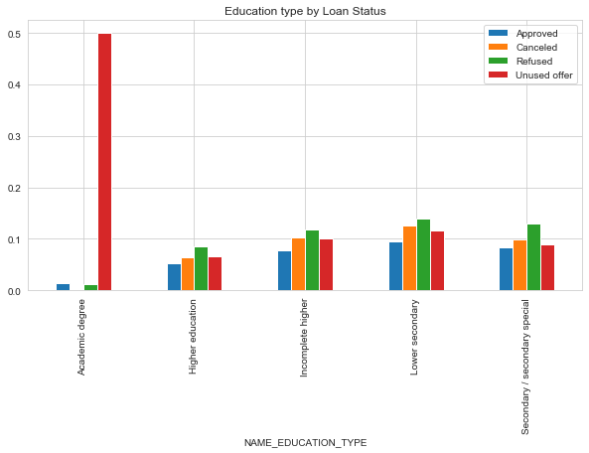
Pivot Table Analysis for NAME_EDUCATION_TYPE by Loan Application Status

Slide 20
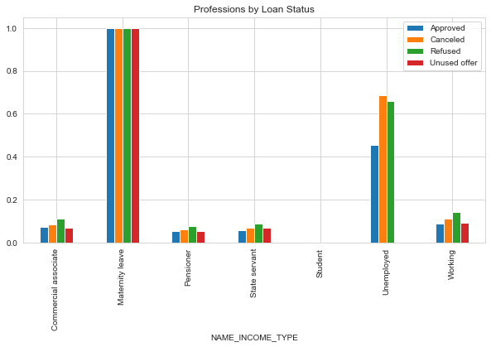
Pivot Table Analysis for NAME_INCOME_TYPE by Loan Application Status

Slide 21
CONCLUSION
Banks should focus more on new applicants those who belong to IT staff, Accountants, Medicine Staff or Private Service Staff group since the loan statuses(approved, refused, cancelled) are stable for such groups.
Banks should not focus more on Low-skill laborers, Laborers and Drivers occupation type as they have a high refusal rate.
Income level do not affect the loan application statuses and hence bank can choose to focus on other attributes.
Secondary education and lower education is a stable education group to focus for approval of loans as the number of applicants for these groups is higher.
Banks should target Working, Commercial associate and State servants income type as number of applicants as well as the stats are stable.

